Slide 1
MICRO Project On teacher student assistant
Cummins College of Engineering
Department of Computer Engineering
Submitted by:
Achala Jadhav (3301)
Karishma Galande (3317)
BTech 2019-20

Slide 2
INTRODUCTION
1. There was a time when education was associated with money, but the things have been
changed now.
2. Great education for students is no more a dream.
3. The Problem With Traditional Study Included:
No time flexibility
Education is expensive
No proper study material
4. The proposed application deals with the interaction between student and teacher.
5. It is used for the purpose of giving assignments, providing notes, attempting quiz, solving students queries.
6. The application uses the database which is firebase and it is provided by google. In this application the teacher and student can login through e-mail, Gmail, phone number.

Slide 3
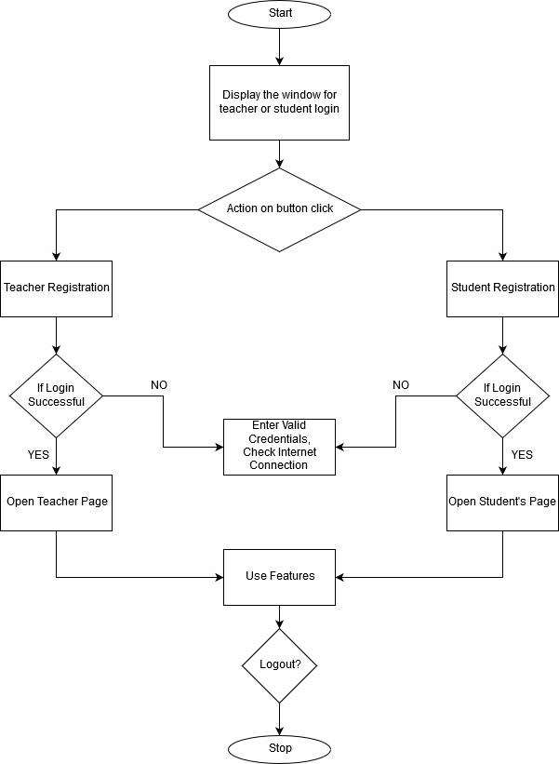
SYSTEM ARCHITECTURE

Slide 4
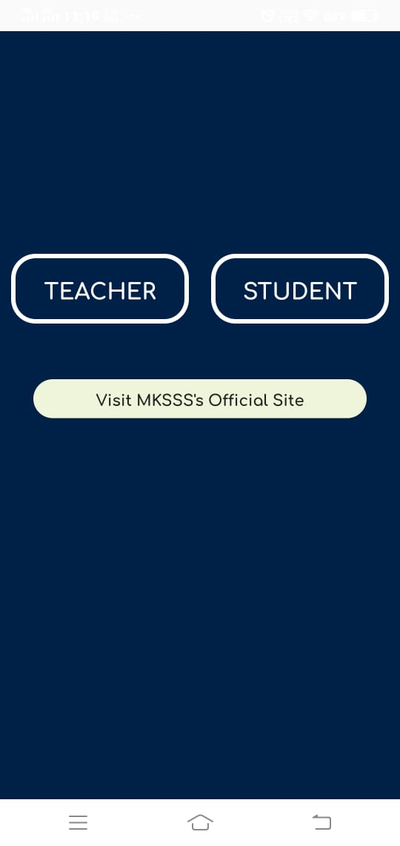
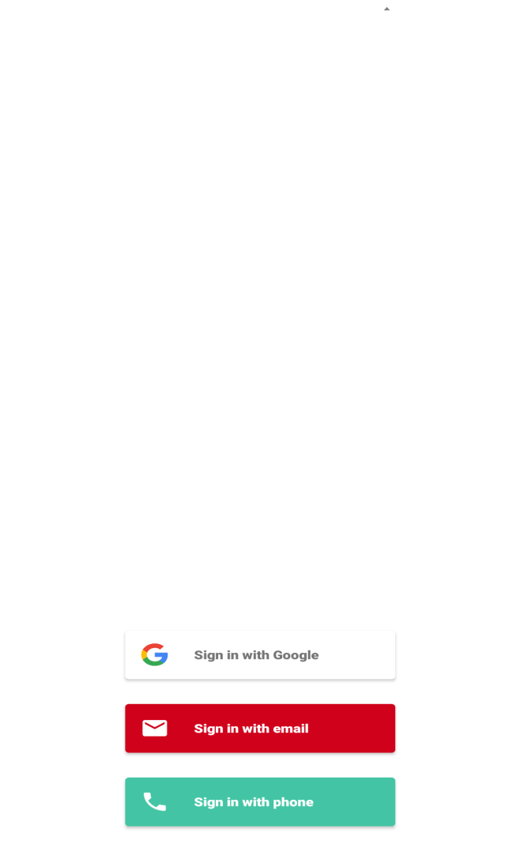
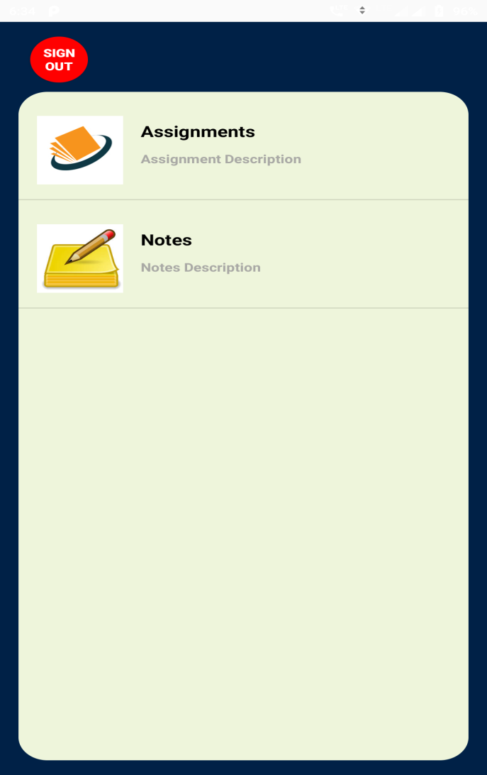
DESIGN

Slide 5

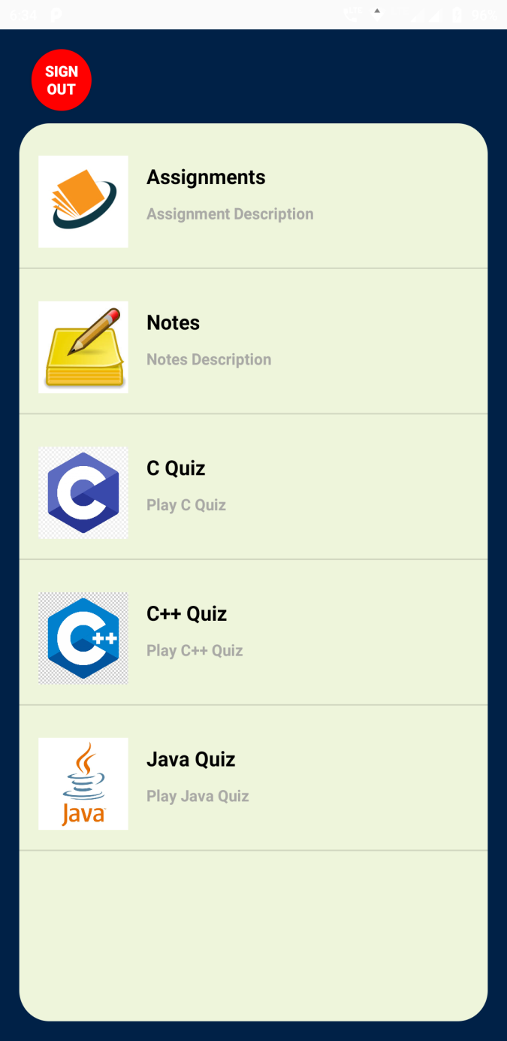
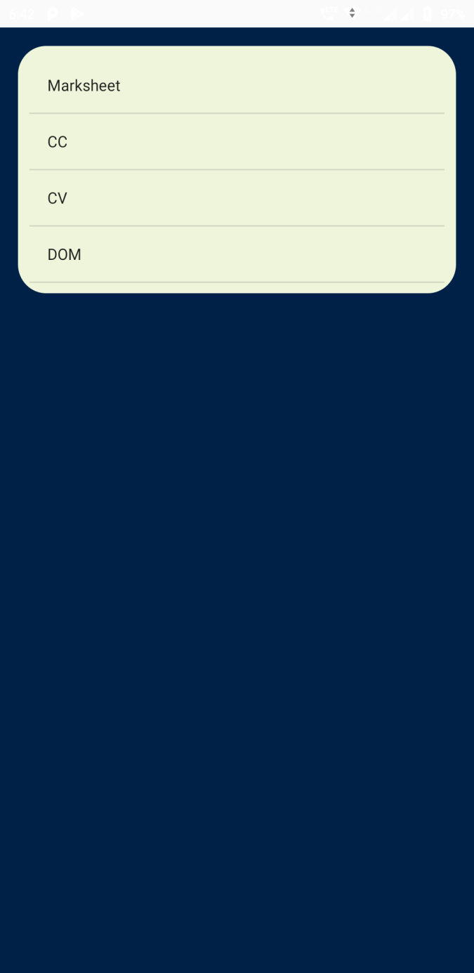

Slide 6

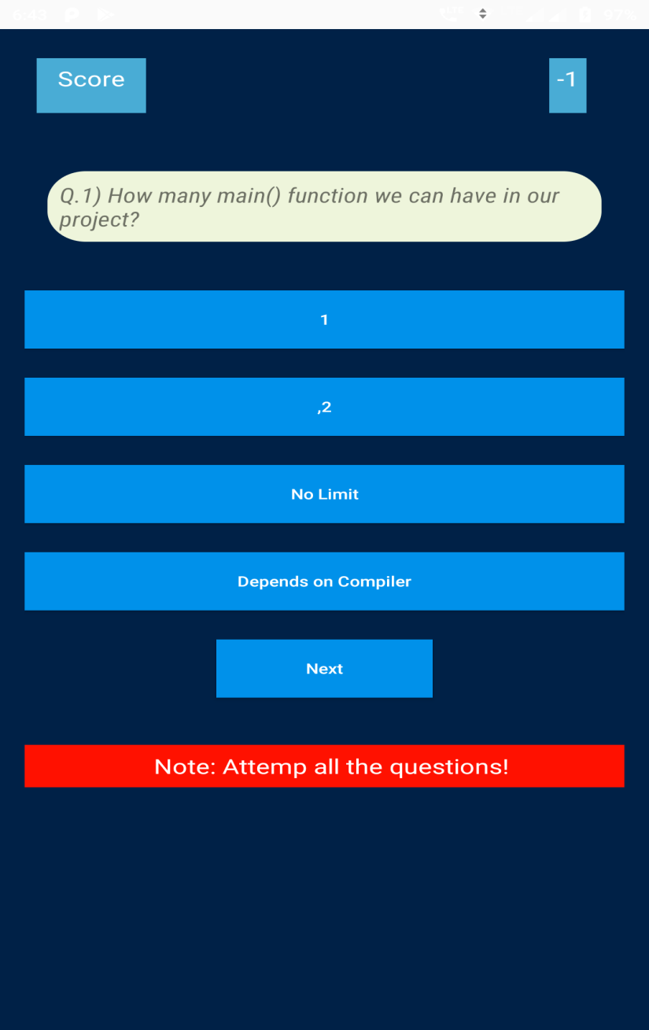

Slide 7
TECHNOLOGY FEATURES Used
Widgets:
Button
Edit Text
Toast
Text View
Layouts:
Linear Layout
Relative Layout
Constraint Layout
Intents:
Explicit Intent
Implicit Intent

Slide 8
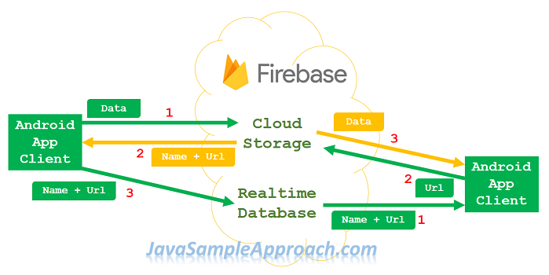

Slide 9
LIMITATIONS
Results in a lack of interest in studying.
Negative views on technology.
Many experts and experienced people say that, due to such technology in education, students imagination is affected, their thinking ability is reduced.
Limited access to sufficient qualities of a technology.
Using tech can cause some students to disconnect from the classroom.
Some students may not know the difference between reliable and unreliable resources.

Slide 10
FUTURE SCOPE
It is not possible to develop a system that makes all the requirements of the user. User requirements keep changing as the system is being used. Some of the future enhancements or scope that can be done to this system is:
As the technology emerges, it is possible to upgrade the system and can be adaptable to desired environment.
Any further changes can be easily adaptable.
Based on the future security issues, security can be improved using emerging technologies.
Many new features can be easily added to the system.
Can be used in Schooling, Institutes, Coaching Classes, etc. levels.
Can be further used for toddlers for virtually teaching purpose.
Develop bigger network of Teacher-Student interactions with more queries and their solutions.

Slide 11
references
Websites [1] https://stackoverflow.com/ [2] https://medium.com/ [3] https://www.youtube.com/ [4] https://github.com/ [5] https://www.sanfoundry.com/ [6] https://developer.android.com/reference/

Slide 12
THANK YOU

